Slide 1

Solution of Linear Systems
Numerical Methods

Slide 2
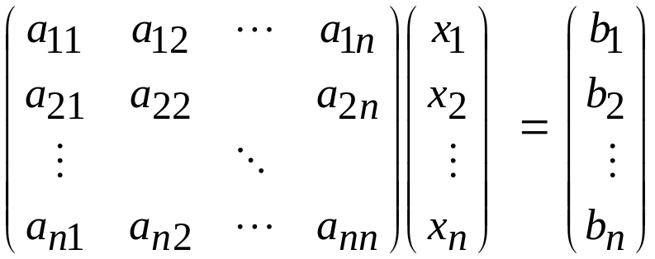
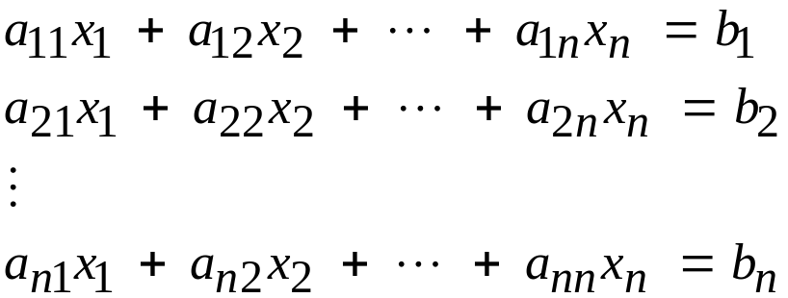
Systems of Linear Equations
Consider the linear system Ax = b
where A is an (n x n) matrix, x is the vector of (n) unknown solution values, and b is a column vector of constants

Slide 3


Solution of a Linear System
A formal way to obtain a solution using matrix algebra is to multiply each side of the equation by the inverse of A to yield

Slide 4
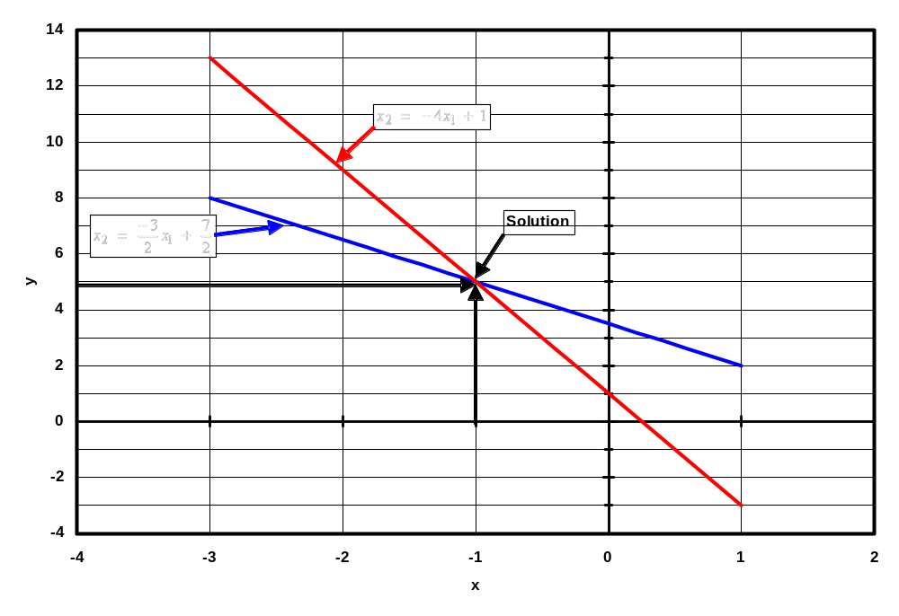
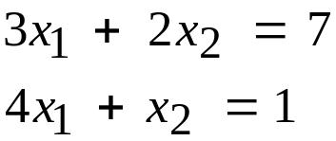
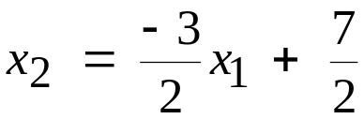

Example
2 equations in 2 unknowns

Slide 5
Gauss Elimination
Forward Elimination - multiple of one equation is subtracted from another to eliminate unknowns
Back Substitution – last equation yields unknown, substituting back into the other equations yields the rest

Slide 6
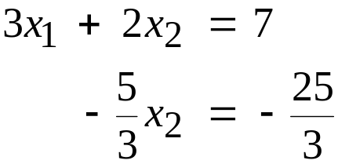
Gauss Elimination
Consider the two equations from the previous example
Divide the first equation by 3, multiply it by 4 and subtract it from the second equation, yielding the new system of equations

Slide 7

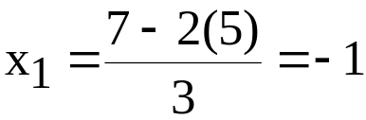
Gauss Elimination
Solve the second equation for x₂
Substitute back into the first equation, solve for x₁

Slide 8
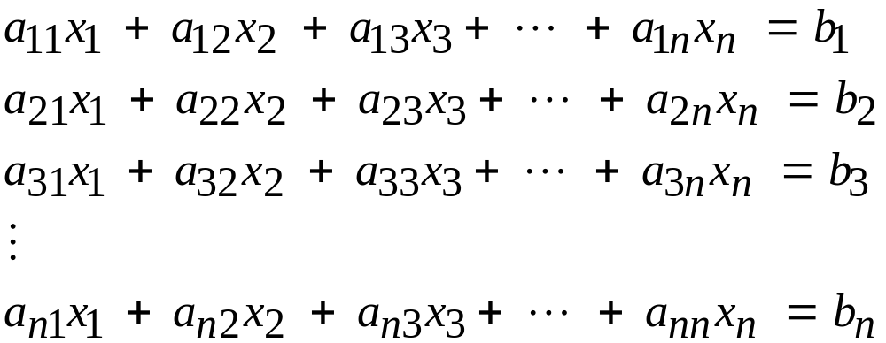
Gauss Elimination
Consider n equations in n unknowns
or
The solution vector, x, for this system of equations remains unchanged if either of the following fundamental row operations are performed:
  Multiply or divide any equation by a constant.
  Replace any equation by the sum of that equation and any other equation.

Slide 9

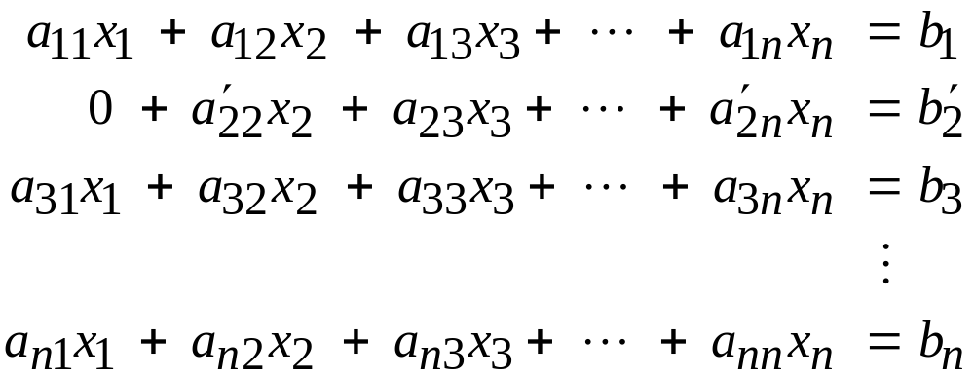
Forward Elimination

Slide 10


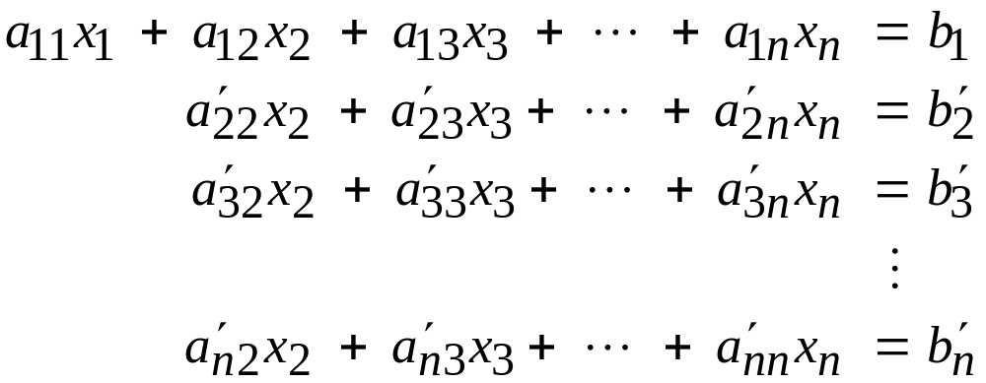
Forward Elimination

Slide 11
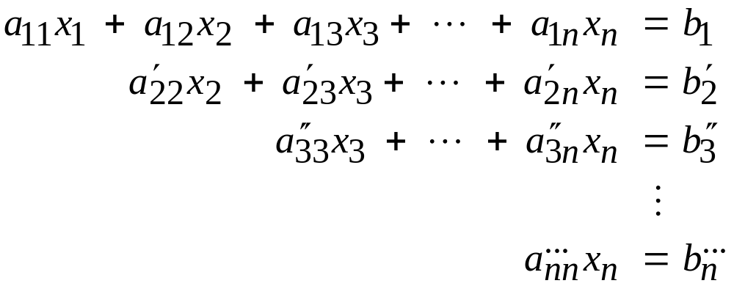
Forward Elimination

Slide 12
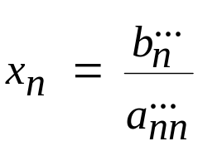
Forward Elimination

Slide 13
Upper Triangular Systems
Volunteer: tell us how to solve this?
(hint: this is not difficult)

Slide 14
Upper Triangular Systems
1) Solve the N^{th} equation
2) Use the value from step 1 to solve the (N-1)^{th} equation
3) Use the values from steps 1 and 2 to solve the (N-2)^{th} equation
4) keep going until you solve the whole system.

Slide 15
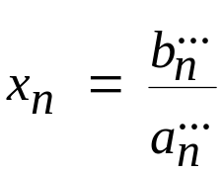
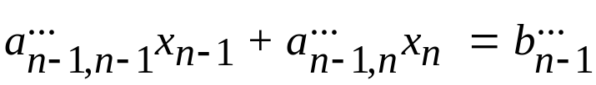
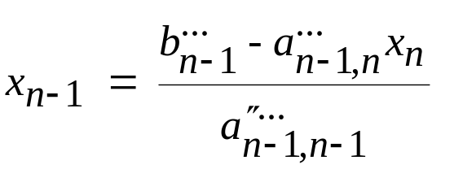
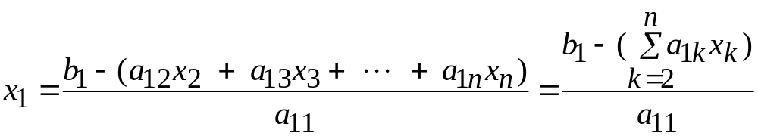
Back Substitution
Finally

Slide 16
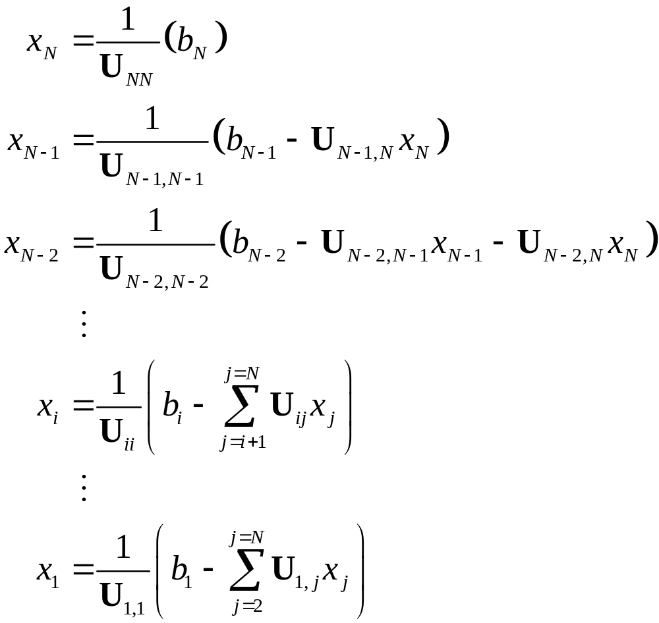
Back Substitution

Slide 17
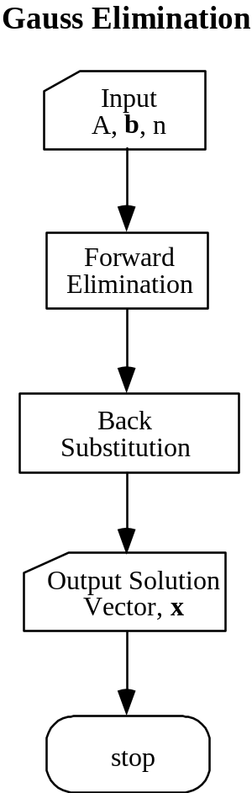
Gauss Elimination

Slide 18
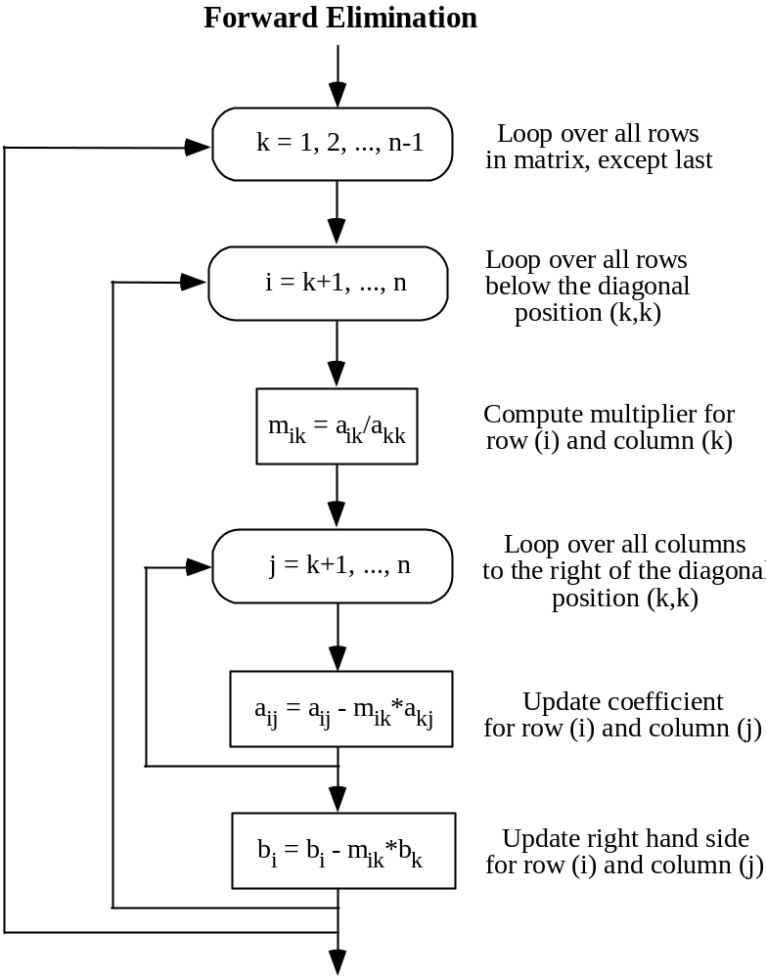
Gauss Elimination

Slide 19
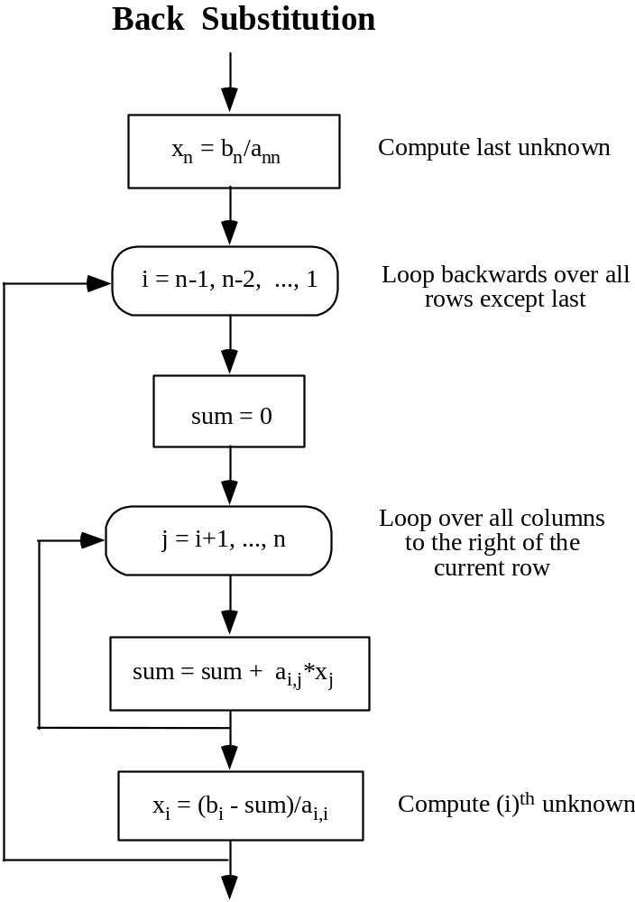
Gauss Elimination

Slide 20
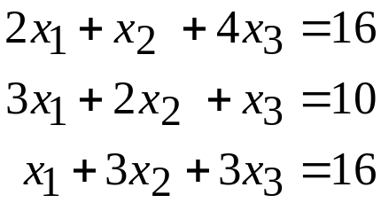
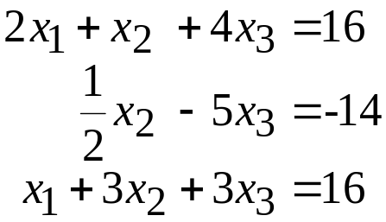
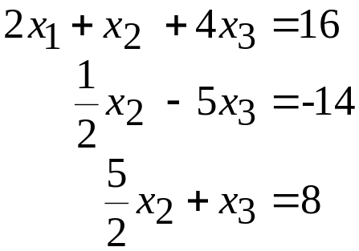
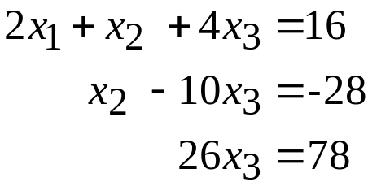
Example
Forward Elimination

Slide 21
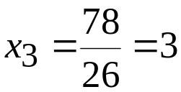
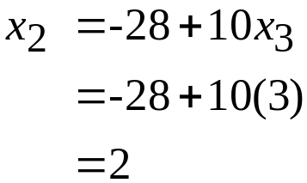
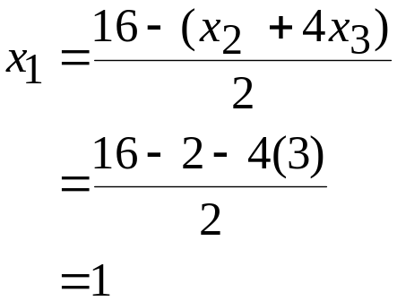
Example
Back Substitution

Slide 22
Home assignment (optional)
Page 108 – Exercises 1(i) and 4
Page 118 – Exercises 2 and 5(b)
Home assignment (mandatory)
Page 124 – Exercises 3 and 4(a)
Pages 137 and 138 – Exercises 1 and 9

Slide 23
LU Factorization
By now you should be persuaded that it is not difficult to solve a problem of the form Lx=b or Ux=b using forward/backward elimination
Suppose we are given a matrix A and we are able to find a lower triangular matrix L and an upper triangular matrix U such that:
A = LU
Then to solve Ax=b we can solve two simple problems:
  Ly = b
  Ux = y
  (sanity check LUx = L(Ux) = Ly =b)

Slide 24
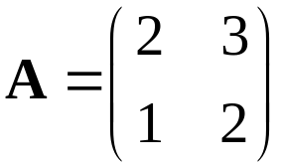
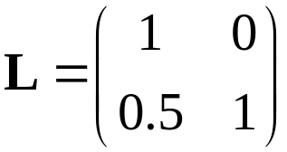
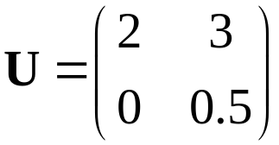
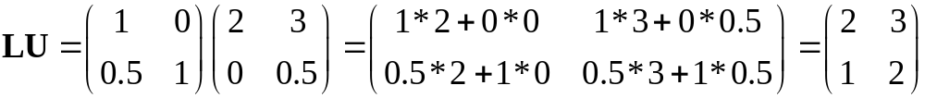
Example LU Factorization
Suppose we are given:
Then we can write A = LU where:
Let’s check that:
☺

Slide 25
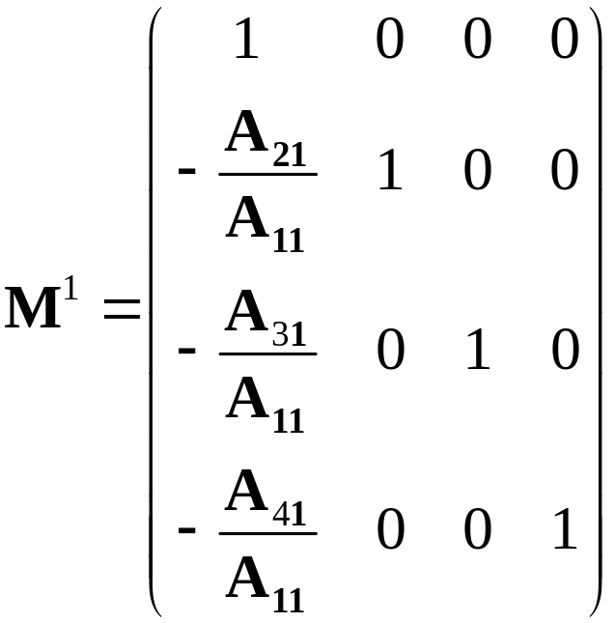
LU Factorization (in words)
Construct a sequence of multiplier matrices
(M¹, M², M³, M⁴,…., M^{N-1}) such that:
(M^{N-1}…. M⁴ M³ M² M¹)A is upper triangle.
A suitable candidate for M¹ is
the matrix ( 4 by 4 case):

Slide 26
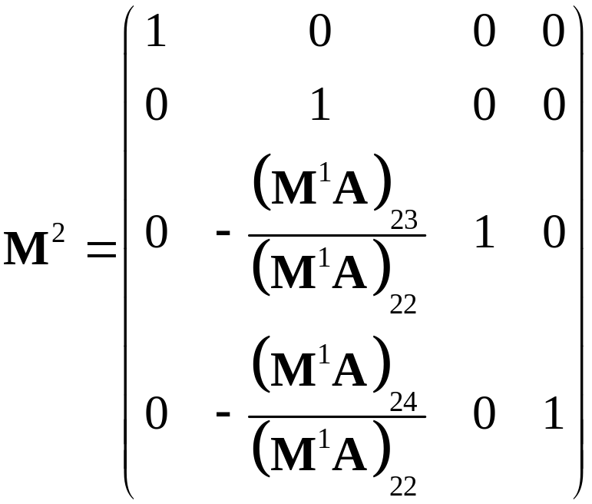
LU Factorization cont.
A suitable candidate for M² is
the matrix ( 4 by 4 case):

Slide 27
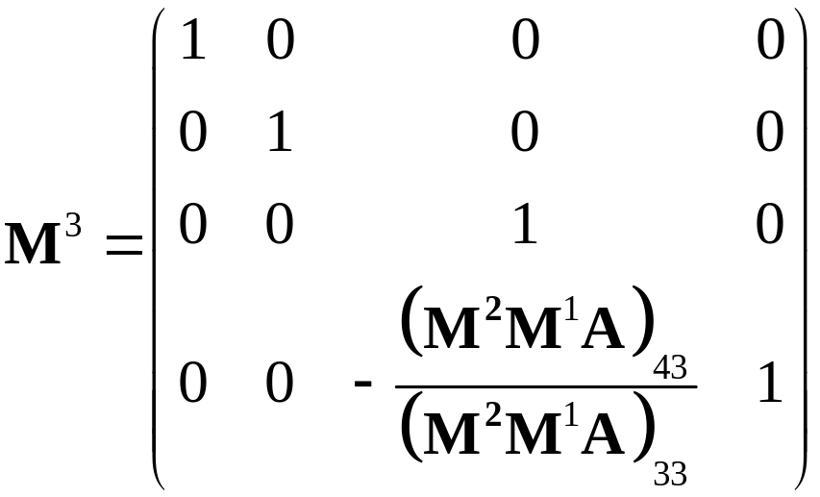
LU Factorization cont.
A suitable candidate for M³ is
the matrix ( 4 by 4 case):

Slide 28
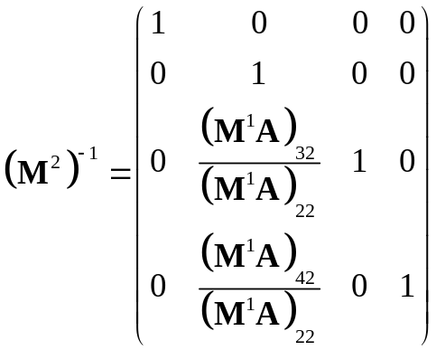
LU Factorization cont.
So in this case: U=(M³M²M¹)A is upper triangle
Each of the M matrices is lower triangle
The inverse of M² looks like:
Using the fact that the inverse of the each M matrix just requires us to negate the below diagonal terms
A = (M³M²M¹)⁻¹ U
= (M¹)⁻¹ (M²)⁻¹ (M³)⁻¹ U
Define L = (M¹)⁻¹ (M²)⁻¹ (M³)⁻¹ and we are done since the product of lower matrices is a lower matrix ☺

Slide 29
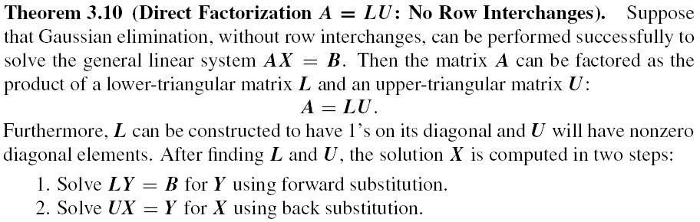
Reading (p143):
Page 143 – Example 3.21

Slide 30
When Basic LU Does Not Work
Remember that we are required to compute
1/A(i,i) for all the successive diagonal terms
What happens when we get to the i’th diagonal term and this turns out to be 0 or very small ??
At any point we can swap the i’th row with one lower down which does not have a zero (or small entry) in the i’th column.
This is known as partial pivoting.

Slide 31
Partial Pivoting
Remember before that we constructed a set
of M matrices so that
is upper triangle
Now we construct a sequence of M matrices
and P matrices so that:
is upper triangle.
(M^{N-1}…. M⁴ M³ M² M¹)A
(M^{N-1} P^{N-1} …. M⁴ P⁴ M³ P³ M² P² M¹ P¹)A

Slide 32
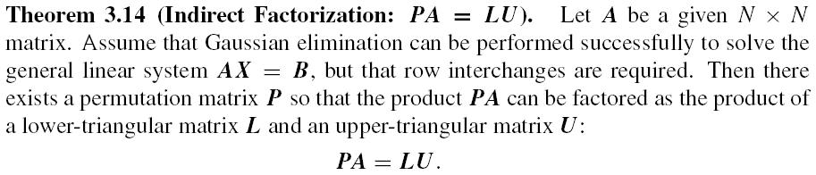
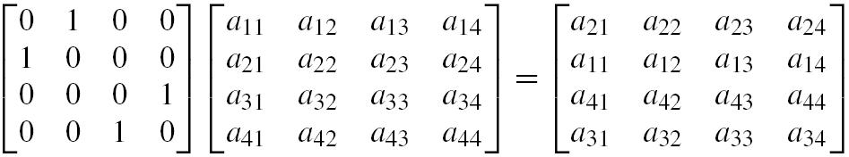

Permutation matrix

Slide 33
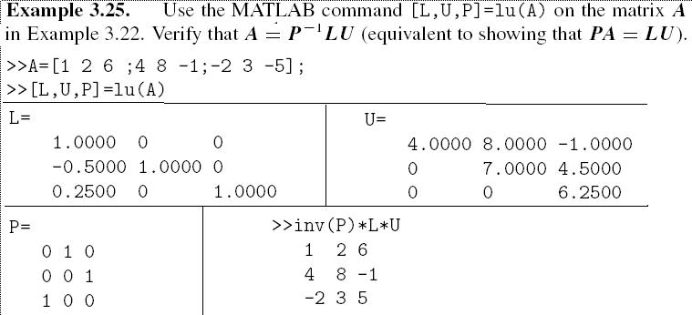
Reading (p151):
Page 151 – Example 3.25

Slide 34
Home assignment
Page 153 – Exercises 1(a), 4 and 6
Corresponding to Exercise 1(a),
read Page 142 – Example 3.20

Slide 35


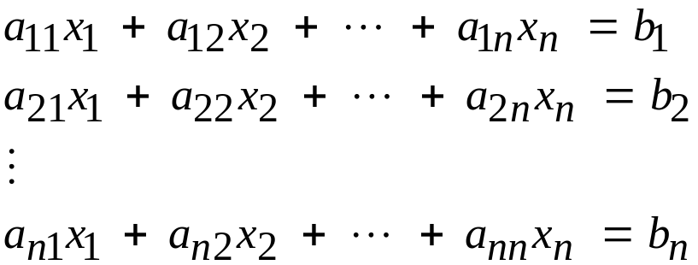
Iterative Methods
Consider the linear system
or

Slide 36
Solution Methods
Gauss Elimination – Subject to roundoff errors and ill conditioning
Iterative methods -- Alternative to elimination method
Take initial guess of solution and then iterate to obtain improved estimates of the solution
Jacobi and Gauss-Seidel methods
Work well for large sets of equations

Slide 37
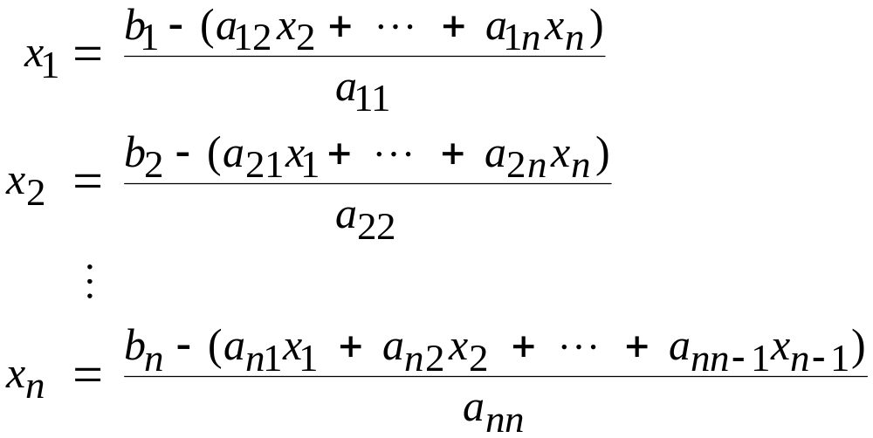

Iterative Methods
Rearrange the equations so that an unknown is on the left-hand side of each equation:
Initial guess

Slide 38
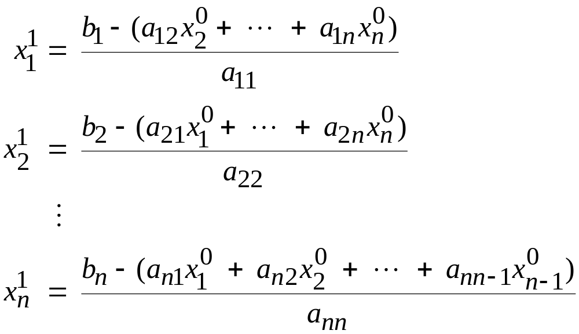
Jacobi Method
Initial guess
Next approximation of the solution

Slide 39
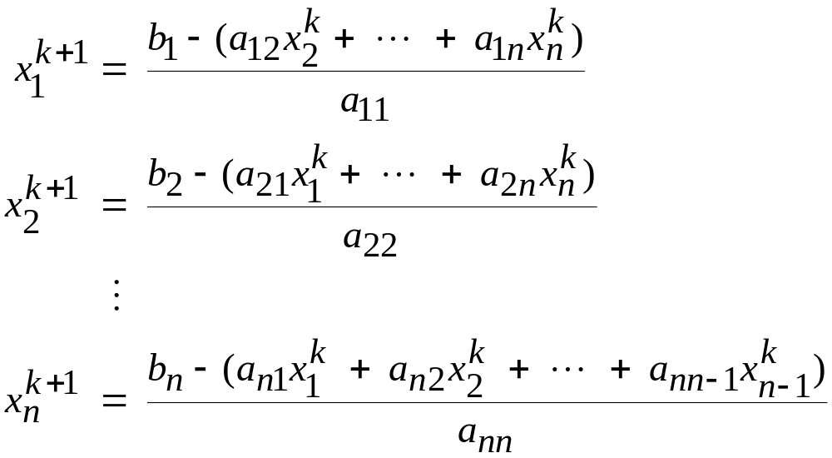
Jacobi Method
After k iterations of this process

Slide 40
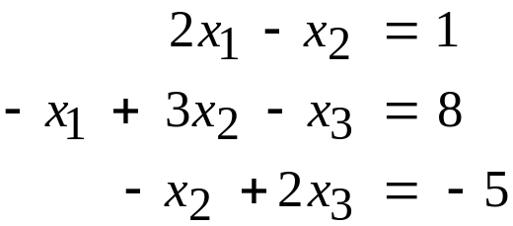
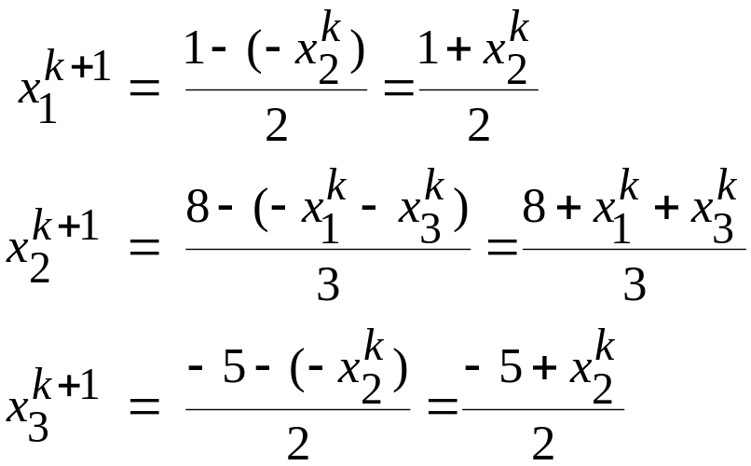
Example – Jacobi Method
System of 3 equations in 3 unknowns
Rearrange

Slide 41

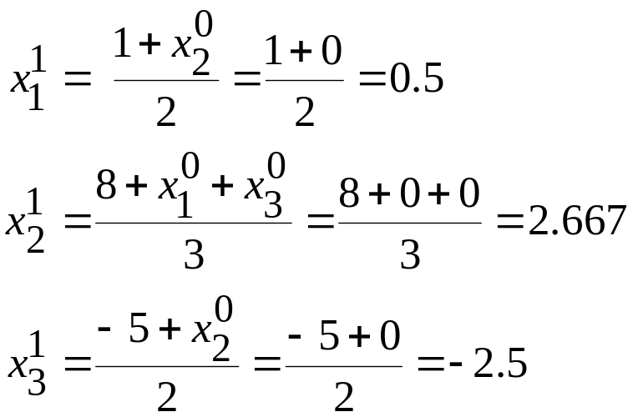
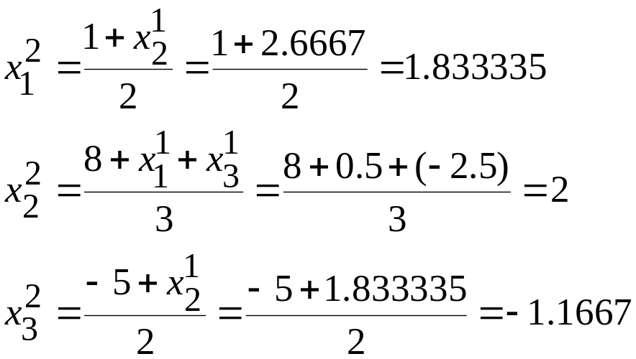

Example – Jacobi Method
Initial guess
After 20 iterations

Slide 42


Errors and Stopping Criteria
How do we know when to stop?
Two major sources of error in numerical methods:
  Roundoff error: Computers represent quantities with a finite number of digits
  Truncation error: Numerical methods employ approximations to represent exact mathematical operations and quantities
Consider the error between the numerical and analytical solutions
  True value
  Approximate value

Slide 43


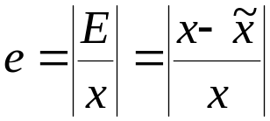
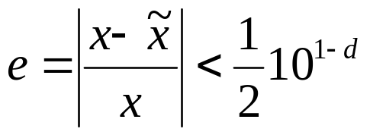
Error Measures
True value = Approximate value + Error
E = Error = True value - Approximate value
e = relative error
d = significant digits

Slide 44
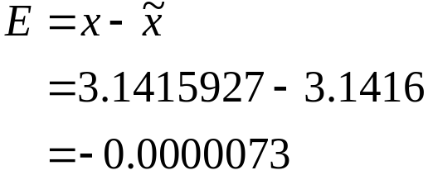


Example
Pi ~ 3.1416
Better approximation x = 3.1415927.
Find the error, relative error and the number of significant digits in the approximation.

Slide 45


Approximate Error
E_{A} is the approximate error between the current approximate value and our previous approximate value

Slide 46


Example
Estimate exp(x) for x = 0.5 by adding more and more terms to the sequence and computing the errors after adding each new term. Add terms until the estimate is valid to three significant digits.
From a calculators y = 1.648721271

Slide 47



Example
Using only the first term of the series,
Using the first and second terms of the series, and so on …
# of Terms | Result | err
1 | 1 | 0.393
2 | 1.5 | 0.09
3 | 1.625 | 0.014
4 | 1.645833333 | 0.0017
5 | 1.648437500 | 0.00017
6 | 1.648697917 | 0.000014

Slide 48


Jacobi Method
We stop when

Slide 49

Gauss Seidel Method
The current approximation of one of the unknowns is available for use after each step.
This information could be used immediately in the calculation of the next unknown

Slide 50



Gauss-Seidel Method - Example
convenient initial guess
after 1 iteration of the method

Slide 51



Gauss-Seidel Method
after 2 iterations
after 1 iteration
after 9 iterations

Slide 52


Convergence condition

Slide 53
Home assignment
Page 165 – Exercises 1, 3 and 5

